Slide 1
COLLING LOAD CALCULATION OF CONFERENCE HALL 1 & 2 OF MECHANICAL DEPARTMENT, IIT GUWAHATI
Presented by
Nikhil Kumar (214103315)
Rishabh Sharma (214103333)

Slide 2
Key information for load estimation
Orientation of building
Physical dimensions of spaces
Ceiling height
Construction materials
Windows
Doors
People (occupancy- nature of activity)
Lighting
Appliances
Ventilation and infiltration

Slide 3
Specification of Conference Hall
Parameter | Conference Hall 1 | Conference Hall 2
Length (ft) | 56.5 | 56.5
Width (ft) | 34.5 | 44.75
Height (ft) | 17 | 17
Thickness of wall (ft) | 1.75 | 1.75
Number of door | 3 | 3
Height of door (ft) | 2.33 | 2.33
Thickness of door (ft) | 3 | 3
Width of door (ft) | 4.5 | 4.5
Number of people | 130 | 200
Total lights | 42 | 54
Number of speakers | 4 | 4
Number of projectors | 2 | 2

Slide 4
DESIGN CONSIDERATIONS
Outdoor Design Condition:
at peak time, DBT= 95˚F(35˚C),
90% RH (for Guwahati)
Indoor Design Condition:
at peak time, DBT= 77˚F(25˚C),
50% RH

Slide 5
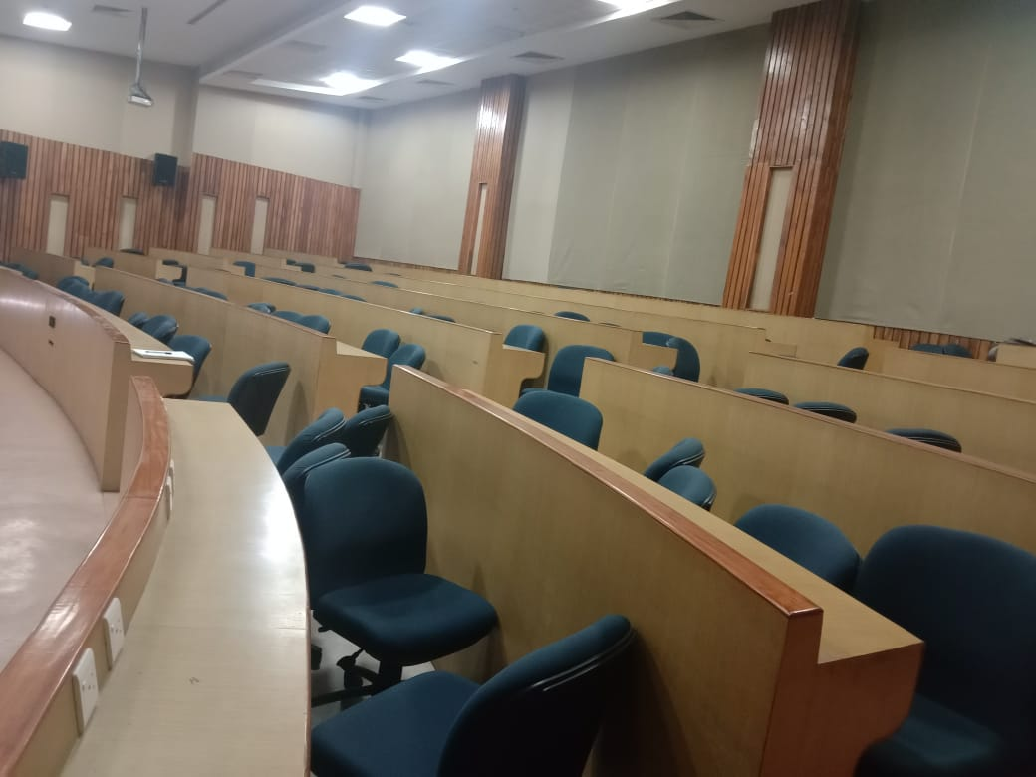
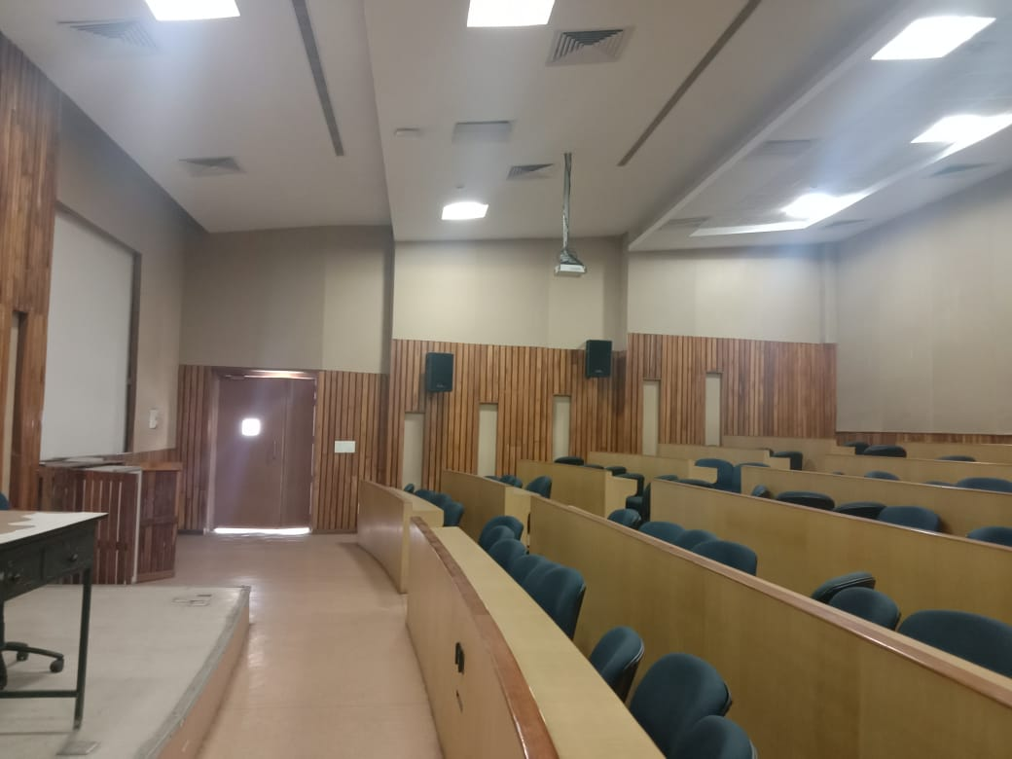

Slide 6
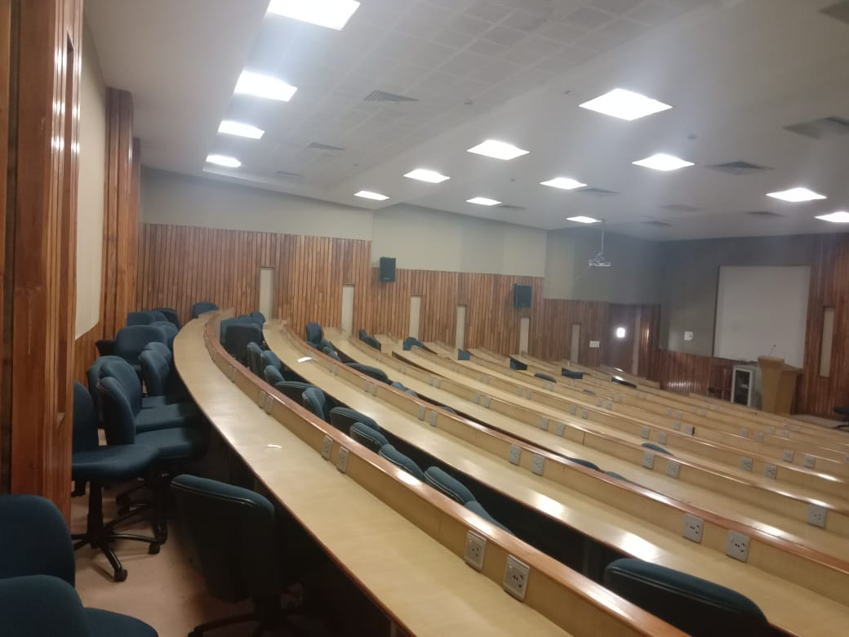

Slide 7
CALCULATION OF CLTD CORRECTION
CLTD_{C} = [CLTD + (78 – TR) +(TM – 85)]
Where
TR= inside design temp= 77˚ F
Daily range= max DBT- min DBT
= 35-25 = 10˚ C (from Guwahati climate graph)
TM=Mean outdoor temp= Max outdoor temperature-(Daily range/2)
= 35-10/2= 30˚ C or 86˚ F
CONFERENCE HALL 1
CONFERENCE HALL 2
 | CLTD (˚F) | CLTDc (˚F)
East wall | 34 | 36
 | CLTD (˚F) | CLTDc (˚F)
East wall | 34 | 36

Slide 8

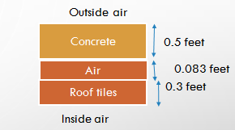
Calculation of overall Heat transfer co-coefficient
For roof
Btu/hr.ft².°F

Slide 9
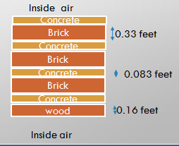
Calculation of overall Heat transfer co-coefficient
For interior walls
Btu/hr.ft².°F

Slide 10
Calculation of overall Heat transfer co-coefficient
For exterior walls
Btu/hr.ft².°F

Slide 11
Calculation of heat load through wall
EXTERIOR WALL
Q= U×A× CLTDc
CONFERENCE HALL 1
CONFERENCE HALL 2
 | Area | CLTDc (˚F) | U | Q (btu/hr)
East wall | 550.5 | 36 | 0.1489 | 2950.9
 | Area | CLTDc (˚F) | U | Q (btu/hr)
East wall | 724.75 | 36 | 0.1489 | 3884.94

Slide 12
Calculation of heat load through wall
Q=U*A*∆T
INTERIOR WALL
 | A | ∆T | U | Q (btu/hr)
North wall | 960.5 | 10 | 0.1452 | 1394.64
South wall | 960.5 | 10 | 0.1452 | 1394.64
West wall | 514.5 | 10 | 0.1452 | 747.05
CONFERENCE HALL 1
 | A | ∆T | U | Q (btu/hr)
South wall | 960.5 | 10 | 0.1452 | 1394.64
North wall | 960.5 | 10 | 0.1452 | 1394.64
West wall | 688.75 | 10 | 0.1452 | 1000
CONFERENCE HALL 2

Slide 13
Calculation of heat load through Roof
For Roof
Q= U×A× CLTDc
 | Area | CLTDc (˚F) | U | Q (btu/hr)
Conference hall 1 | 1949.25 | 25 | 0.1504 | 7329.18
Conference hall 2 | 2528.375 | 25 | 0.1504 | 9506.69

Slide 14
Calculation of people load
For People load calculation
Q s (Btu/hr) = N (number of people) x SHG (Btu/hr) x CLF
Q l (Btu/hr) = N (number of people) x LHG (Btu/hr
Assumption: (10 hrs per day work )
CLF=0.77
CONFERENCE HALL 1
Assumption: Standing, walking slowly
SGH= 220 Btu/hr ,LGH=280 Btu/hr
N=130
Qs =130×220×0.77 = 22022 Btu/hr
Ql = 130×280 = 36400 Btu/hr
CONFERENCE HALL 1
Assumption: Standing, walking slowly
SGH= 220 Btu/hr ,LGH=280 Btu/hr
N=200
Qs =200×220×0.77 = 33880 Btu/hr
Ql = 200×280 = 56000 Btu/hr

Slide 15
Calculation of lighting load
For Light load calculation
CLF = 0.45
(Assumption : Heavy weight, Simple Furnishings, no carpet and V* < 0.5, Where V * is the air supply rate in CFM per sq. foot of floor area)
Q (Btu/hr) = 3.4[Btu/hr /Watt] * CLF * W * f(b)
 | Conversion factor | Number of lights | CLF | F(B) | W(rated power) | Q (btu/hr)
Conference hall 1 | 3.4 | 42 | 0.45 | 1.3 | 100 | 8353.5
Conference hall 2 | 3.4 | 54 | 0.45 | 1.3 | 100 | 10740.6

Slide 16
Calculation of window-Door load
Window:
There will be no load for window in conference hall 1 and 2
Door:
 | Td | A | N | U | Q (btu/hr)
Conference hall 1 | 10 | 36 | 3 | 0.288 | 311.04
Conference hall 2 | 10 | 36 | 3 | 0.288 | 311.04

Slide 17
Calculation of load though appliances
Q Sensible = Qin x Fu x Fr x (CLF)
Q Latent = Qin x Fu
Qin = 3.4 x W, CLF = 0.45 (simple furnishing)
Fu= Usage factor ,Fr= Radiation factor ,CLF = Cooling Load Factor
CONFERENCE HALL 1
 | W | Fu | Fr | NUMBER(N) | CLF | Qsensible | Qlatent
Projector | 500 | 0.3 | 0.2 | 2 | 0.45 | 91.8 | 1020
Speaker | 150 | 1 | 0.15 | 4 | 0.45 | 137.7 | 2040
CONFERENCE HALL 2
 | W | Fu | Fr | NUMBER(N) | CLF | Qsensible | Qlatent
Projector | 500 | 0.3 | 0.2 | 2 | 0.45 | 91.8 | 1020
Speaker | 150 | 1 | 0.15 | 4 | 0.45 | 137.7 | 2040

Slide 18
Calculation of infiltration load
Q Sensible= 1.08 * CFM * ΔT
Q Latent= 4840 * CFM * ΔW
Assumption: Educational institute
CFM(cubic feet of air per minute)=5.5
CONFERENCE HALL 1
CONFERENCE HALL 2
1. Sensible Heat | CFM | ΔT | No of people | Q (btu/hr)
Educational Institute | 5.5 | 10 | 130 | 7722
2. Latent Heat | CFM | ΔW | No of people | Q
 | 5.5 | 0.022 | 130 | 77863.5
1. Sensible Heat | CFM | ΔT | No of people | Q (btu/hr)
Educational Institute | 5.5 | 10 | 200 | 11880
2. Latent Heat | CFM | ΔW | No of people | Q
 | 5.5 | 0.022 | 200 | 119790

Slide 19
Calculation of room total load
CONFERENCE HALL 1
SECTION | SHL(BTU/hr) | LHL(BTU/hr) | Total(BTU/hr)
WALLS | 6487.2463 |  | 6487.2463
Roof | 7329.18 |  | 7329.18
Light | 8353.8 |  | 8353.8
DOORS | 311.04 |  | 311.04
Electrical Appliances | 229.5 | 3060 | 3289.5
People | 22022 | 36400 | 58422
infiltration | 7722 | 77863.5 | 85585.5
Total |  |  | 159936.366
Total(TR) |  |  | 14.16

Slide 20
CONFERENCE HALL 2
SECTION | SHL(BTU/hr) | LHL(BTU/hr) | Total(BTU/hr)
WALLS | 7674,3069 |  | 7674.3069
Roof | 9506.69 |  | 9506.69
Light | 10740.6 |  | 10740.6
DOORS | 311.04 |  | 311.04
Electrical Appliances | 387.6 | 3060 | 3289.5
People | 33880 | 56000 | 89880
infiltration | 11880 | 119790 | 131670
Total |  |  | 253230.2369
Total(TR) |  |  | 21.10

Slide 21
Calculation of ventilation load
Q Sensible= 1.08 * CFM * ΔT
Q Latent= 4840 * CFM * ΔW
CONFERENCE HALL 1
CONFERENCE HALL 2
1. Sensible Heat | CFM | ΔT | No of persons | Q (btu/hr)
Educational Institute | 5.5 | 25 | 200 | 29700
2. Latent Heat | CFM | ΔW | No of persons | Q (btu/hr)
 | 5.5 | 0.0245 | 200 | 130438
1. Sensible Heat | CFM | ΔT | No of persons | Q (btu/hr)
Educational Institute | 5.5 | 25 | 130 | 19305
2. Latent Heat | CFM | ΔW | No of persons | Q (btu/hr)
 | 5.5 | 0.0245 | 130 | 84784.7

Slide 22
Calculation of Total load with ventilation
CONFERENCE HALL 1
SECTION | SHL(BTU/hr) | LHL(BTU/hr) | Total(BTU/hr)
WALLS | 6487.2463 |  | 6487.2463
Roof | 7329.18 |  | 7329.18
Light | 8353.8 |  | 8353.8
DOORS | 311.04 |  | 311.04
Electrical Appliances | 229.5 | 3060 | 3289.5
People | 22022 | 36400 | 58422
infiltration | 7722 | 77863.5 | 85585.5
Ventilation | 19305 | 84784.7 | 104089.7
Total |  |  | 274026.06
Total(TR) |  |  | 22.835

Slide 24
Calculation of total load
CONFERENCE HALL 2
SECTION | SHL(BTU/hr) | LHL(BTU/hr) | Total(BTU/hr)
WALLS | 7674,3069 |  | 7674.3069
Roof | 9506.69 |  | 9506.69
Light | 10740.6 |  | 10740.6
DOORS | 311.04 |  | 311.04
Electrical Appliances | 387.6 | 3060 | 3289.5
People | 33880 | 56000 | 89880
infiltration | 11880 | 119790 | 131670
Ventilation | 29700 | 130438 | 160138
Total |  |  | 413368.236
Total(TR) |  |  | 34.447

Slide 26

For hall 1
To = 35 °C
Ti = 25 °C
Tc = 10 °C
Assumption : 20% fresh air for ventilation
Air entering to room = 21 °C
SHF = room sensible load / total room load
BPF =
Cooling coil efficiency = 1-BPF
Sensible heat factor | Bypass factor | Cooling coil efficiency (%)
0.532 | 0.15 | 85

Slide 27
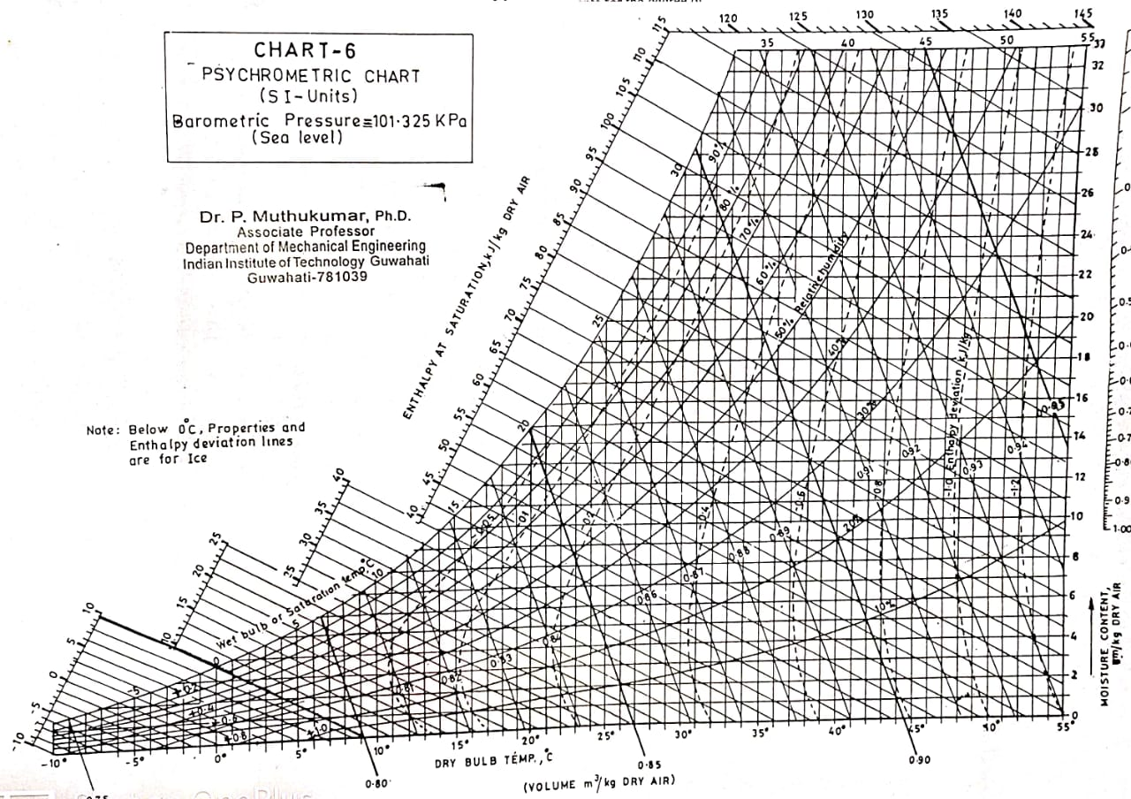
a
c
e
d
b

Slide 28
For hall 2
To = 35 °C
Ti = 25 °C
Tc = 10 °C
Assumption : 20% fresh air for ventilation
Air entering to room = 21 °C
SHF = room sensible load / total room load
BPF =
Cooling coil efficiency = 1-BPF
Sensible heat factor | Bypass factor | Cooling coil efficiency (%)
0.514 | 0.15 | 85

Slide 29
a
c
e
d
b

Slide 30
References
ASHRAE Handbook, 2001
COOLING LOAD PPT Course ME621

Slide 31
Thank you

